Slide 1
SIG WEBSITE PROJECT
SnapPapers Team:
Ramsha Naeem
Harsh Sanjaykumar Pandya
Alejandro Santoscoy Rivero
Sithija Wijesinghe

Slide 2
FEATURES
Homepage
Login page
Visualizations
Word cloud (based on the researcher interests)
Research trends based on publications
Geographical visualization of researchers’ work locations
Profile page
Create and update profile
Bookmark profiles
Explore researchers page
Explore papers
Notes:
GeoLocations (Based on the Location of the university)

Slide 3
What have we been working on
Landing page
Login page
Profiles
Individual profile pages
Explore researchers
Contact us form
Visualizations
Word cloud (based on the researcher interests)
Research trends based on publications
Geographical visualization of researchers’ work locations
Notes:
GeoLocations (Based on the Location of the university)

Slide 4
DEMO
SIG Website

Slide 5
What comes next?
Profiles
Edit
Bookmark
Dynamic data visualization
Explore researcher functionalities,
Search
Filters
Bilingual integration

Slide 6

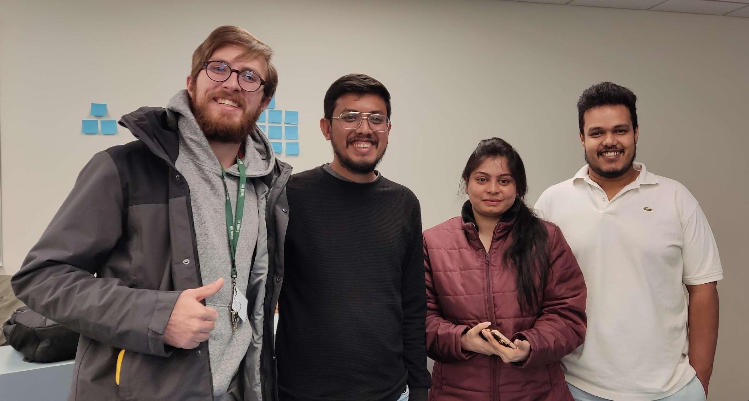
THANK YOU VERY MUCH!
SnapPapers

Slide 7
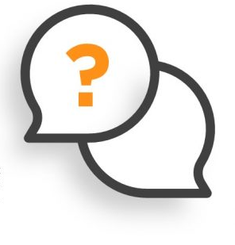

QUESTIONS & ANSWERS

